Slide 1
Linear Regression Implementation from Scratch
Eng Teong Cheah

Slide 2
Objective
We saw how a deep network can be implemented from scratch, using just NDArray and autograd, without any need for defining layers, fancy optimizers, etc. This only scratches the surface of what is possible.

Slide 3
Contents
Linear Regression Implementation from Scratch

Slide 4

Linear Regression Implementation from Scratch

Slide 5
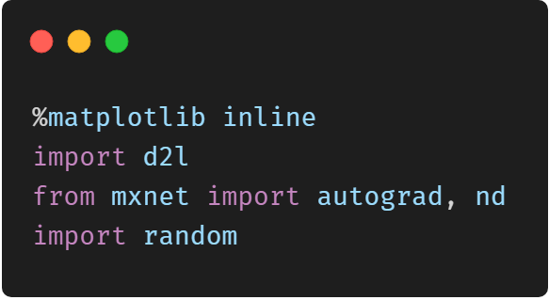
Linear Regression Implementation from Scratch

Slide 6
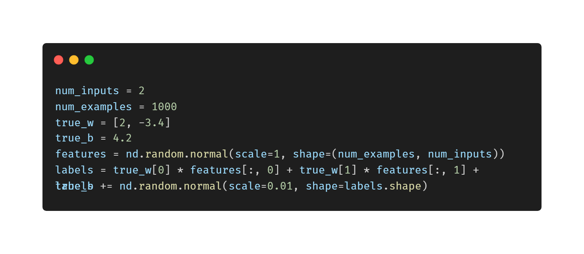
Generating Data Sets

Slide 7
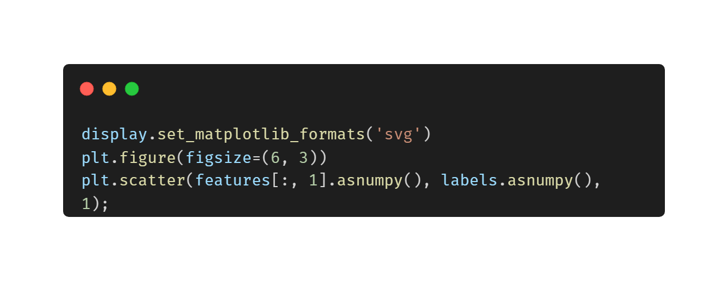
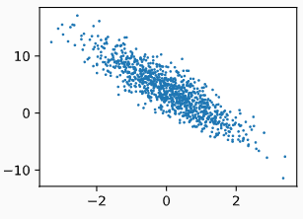
Visualize the Second Feature and Label

Slide 8
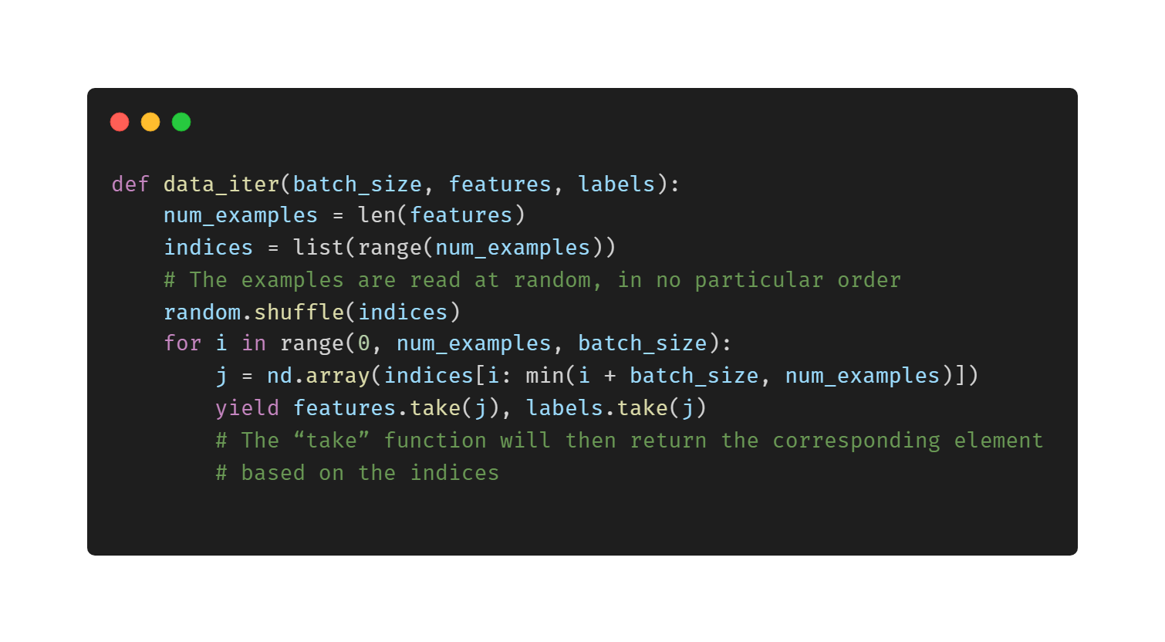
Reading Data

Slide 9
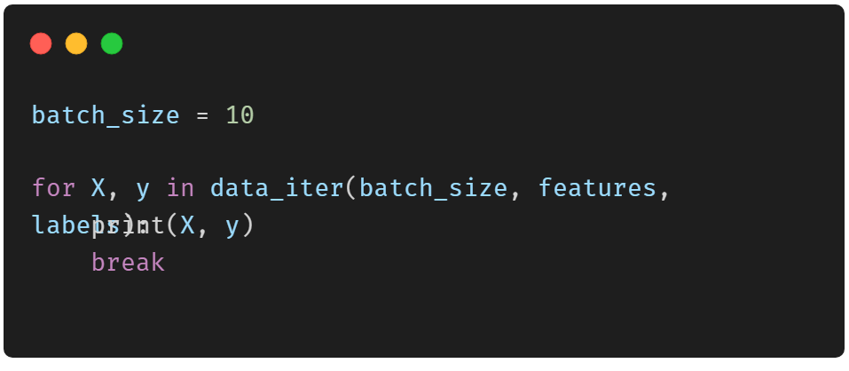
Print a Small Data Batch
[[ 1.7130351 2.0944266 ] [-1.95122 -1.0635319 ] [ 0.22546557 0.8499169 ] [-1.6903632 -0.15907401] [ 0.85316896 1.0389048 ] [-0.17798574 1.410267 [-2.152955 -1.3841926 ] [ 0.8605494 -0.22276537] [-0.33177793 -0.99060804] [ 2.584889 -1.1416703 ]] <NDArray 10x2 @cpu(0)> [ 0.5036066 3.9271483 1.7579273 1.353747 2.3738737 – 4.593405 6.6843915 6.8792953 13.258079 ] NDArray 10 @cpu(0)>

Slide 10
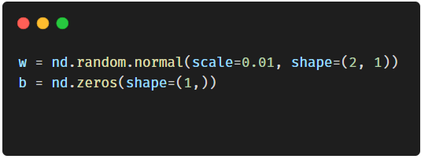
Initial Model Parameters

Slide 11
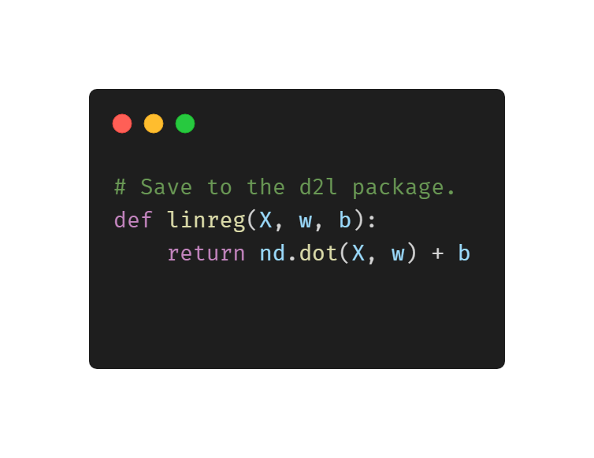
Define the Linear Model

Slide 12
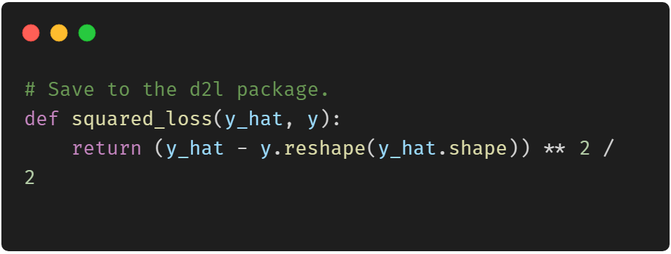
Define the Loss function

Slide 13
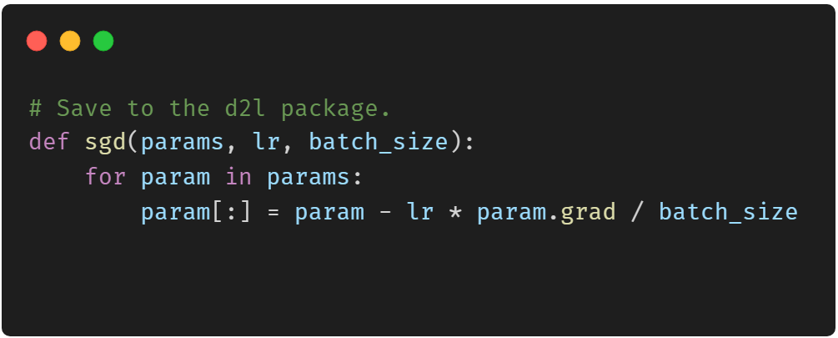
Define the Optimization Algorithm

Slide 14
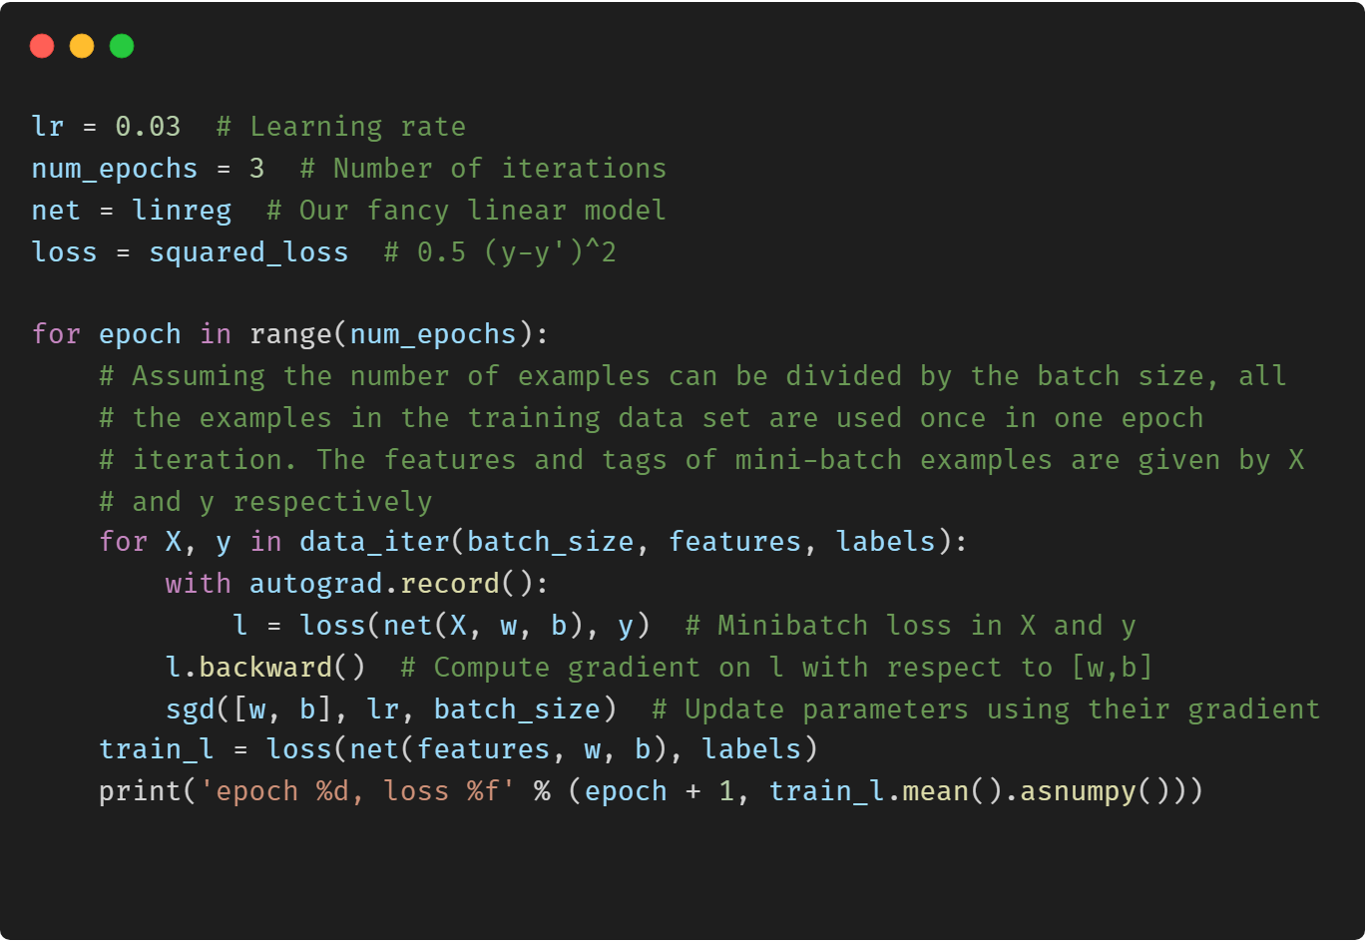
Training

Slide 15
Training

Slide 16
Thanks!
Does anyone have any questions?
Twitter: @walkercet
Blog: https://ceteongvanness.wordpress.com

Slide 17
Resources
Dive into Deep Learning

